Slide 1
Foundations of cloud computing Project I
Team 8
Andrew Stefanich
Fenil Shah
Ravi Voleti

Slide 2
Agenda
Introduction
Executive Summary
Requirements
Assumptions
High Availability and Business Continuity
Architecture
Scalability
Network
Security
Monitoring and Auditing
Next Steps and Conclusion

Slide 3
Introduction
Problem:
A medical company wants to build an online medical social networking and diagnosis assistance application in three regions APAC, US and Europe.The application connects patients and doctors to:
Allow online appointments, remote consultation, remote diagnosis, electronic prescription transfer, and payment services.
Allow customers to upload documents and images. Text is extracted from documents, and images are converted into multiple formats.
Solution:
We solve the following problem by implementing a 3-tiered cloud architecture system.
The web tier handles login and serves web pages to the users for utilizing various apps along with uploading documents to s3 bucket.
The app tier handles online appointments, remote consultation, remote diagnosis, electronic prescription transfer, and payment services.Additionally, the app tier would also allow text processing and image processing from s3 buckets.
The backend has s3 bucket for handling documents, RDS for login and structured data and an elastic cache for faster access.

Slide 4
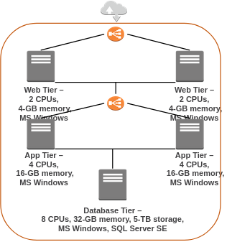
Executive Summary (Project Goals)
Provide infrastructure to support the application use-cases
Design infrastructure for reliability and scalability
Accommodate a multi-region customer base
Replicate existing tier architecture
Support existing Microsoft stack in the cloud
Existing customer architecture

Slide 5
Requirements
Configuring access permissions to conform with AWS best practices.
Building networks that conform to AWS best practices while providing all the necessary network services to the application in their different environments.
Building an architecture that matches the current architecture at the server hosting company and that can handle doubling the number of servers.
Securing all medical information, as medical information usually contains highly sensitive personally identifiable information (PII).
Utilizing load balancers for web tier and application tier that must support HTTP, HTTPS, TCP protocols plans to move their application into AWS.
Architecture should be resilient (built for business continuity).
Configuring auditing to track all user actions.

Slide 6
Assumptions
We will be using a general purpose (T3) instances which satisfy the customer’s requirements.
Web-tier and App-tier instances will have 30GB storage by default.
All the communication would be done through port 443 only.
If there is a region failover, the users will be redirected to a static website from another region.
Data sovereignty must be upheld (data kept within region)

Slide 7
High Availability and Business Continuity
We need to ensure that the application is highly available and has minimum downtime in case of a failover.
We will be using Amazon EC2 Auto Scaling to deal with this.
Amazon EC2 Auto Scaling is used so that the instances are distributed across multiple Availability Zones per region in order to deal with an Availability Zone failover.
Adding Auto Scaling helps ensure that the application will always have the right amount of capacity to handle the traffic.

Slide 8
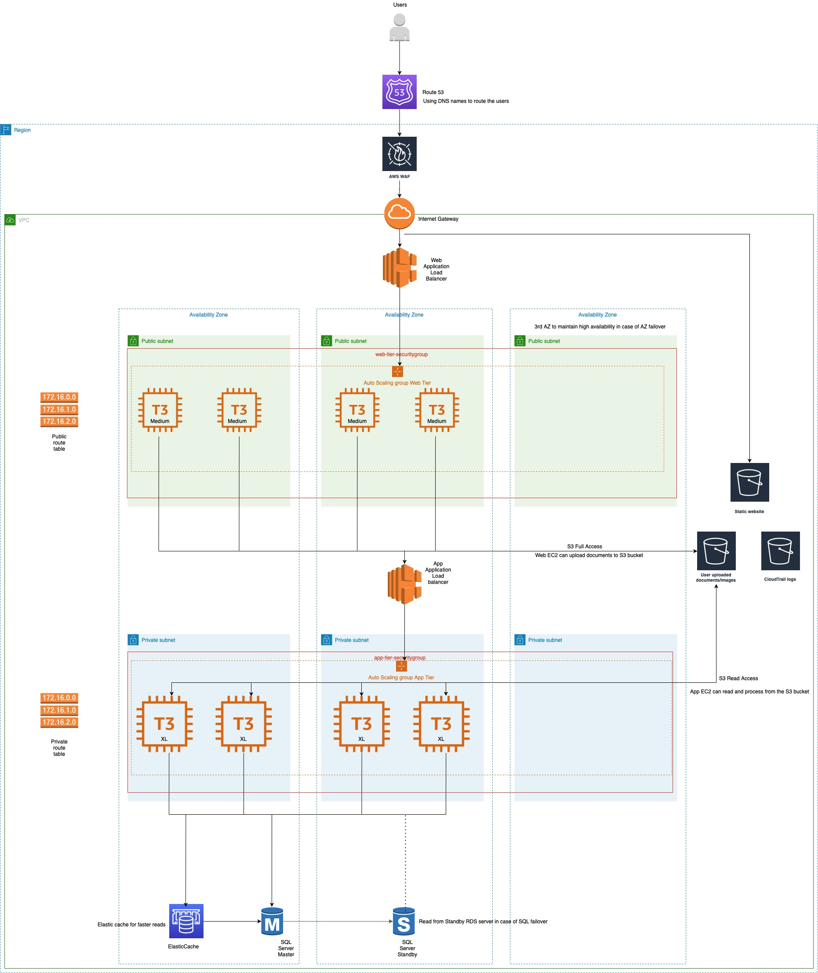
Architecture
3-tier architecture
Web-tier
App-tier
Database
Route53
WAF
Three S3 buckets

Slide 9
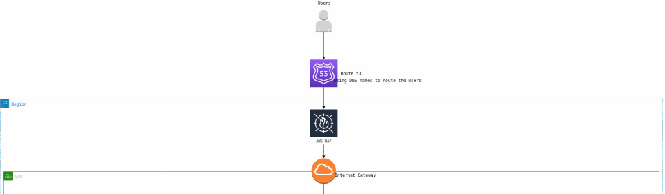
Entry
Route53 used to redirect user to appropriate region
AWS WAF used to protect against common web exploits

Slide 10
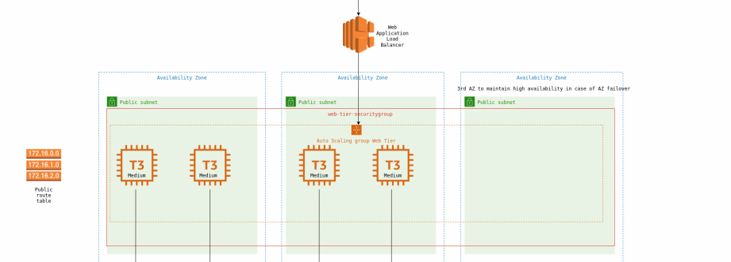
Web-tier
Application Load balancer
AWS EC2 AutoScaling group
Security group

Slide 11
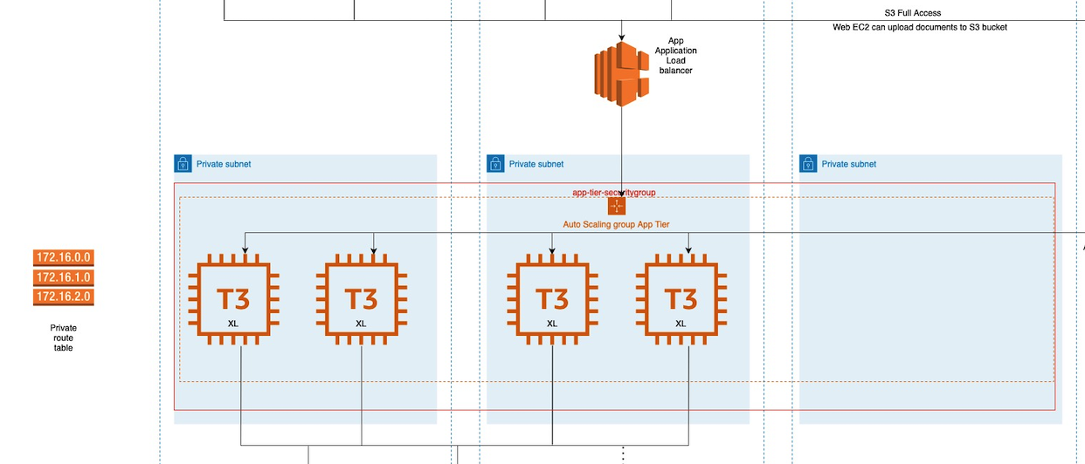
App-tier
Application Load balancer
AWS EC2 AutoScaling group
Security group

Slide 12
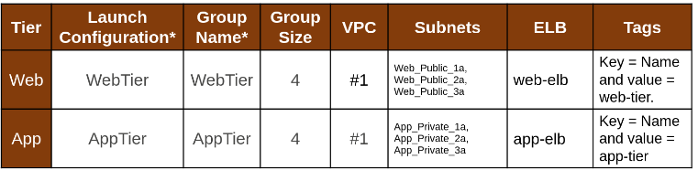
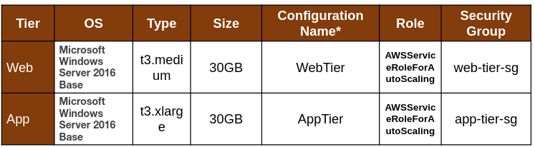
Scalability
Auto-scaling groups
Launch
configurations

Slide 13
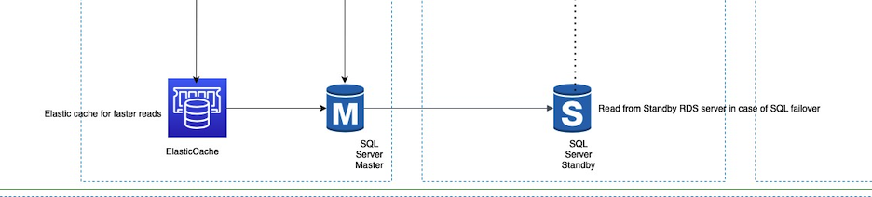
DB-tier
Elasticache
Master Database
Standby Database

Slide 14
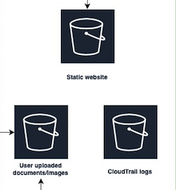
S3 Buckets
S3 static website
Logging bucket
Upload bucket

Slide 15
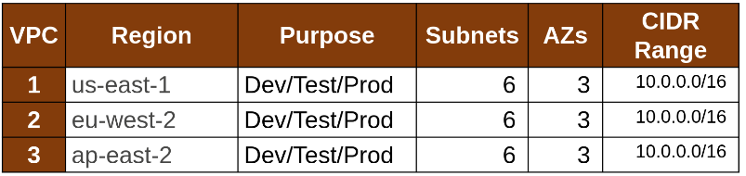
Network (VPCs)
1 VPC per region (3 VPCs total)

Slide 16
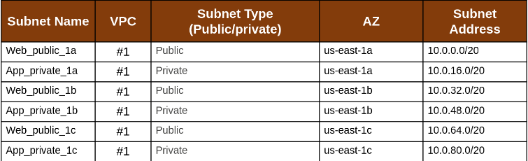
Network (Subnets)
6 subnets per region (3 private/3 public)

Slide 17
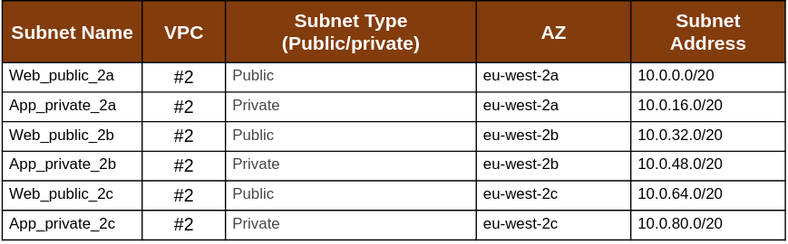
Network (Subnets)
6 subnets per region (3 private/3 public)

Slide 18
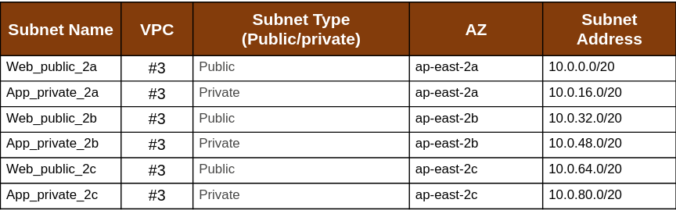
Network (Subnets)
6 subnets per region (3 private/3 public)

Slide 19
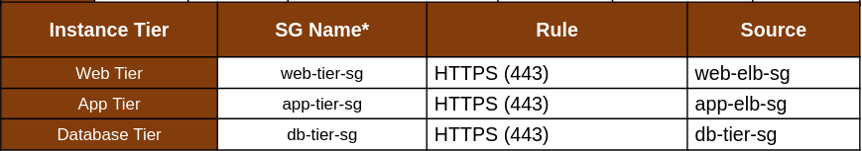
Security
Use of private subnets, no gateway
Web/app tier security groups
Port rules

Slide 20
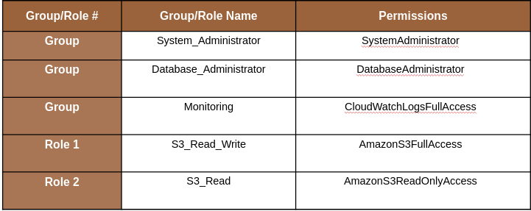
Security
IAM best security practices

Slide 21
Security
Programmatic access: administrators
Console access: all
MFA for administrators
Password policy
8 characters, 1 uppercase, 1 lowercase, 1 number, 1 special
Forced changed every 90 days
No re-use of previous three passwords

Slide 22
Monitoring and Auditing
Services Used:
Cloud Trail for auditing.
Cloud Watch for monitoring.
Reasons:
They are AWS managed services that integrate extremely well with the current architecture.
Continuously monitor, and retain account activity related to actions across your AWS infrastructure.
Log the event history of AWS account activity, including actions taken through the AWS Management Console, AWS SDKs, command line tools, and other AWS services.
Ensure that is an audit trail for all executed API calls.
Ensure that logs are stored in a secure location.

Slide 23
Next Steps and Conclusion
Implement the preceding AWS infrastructure.
Spend time stress testing network/application.
Test for scalability and simulate loss of availability zones and regions for business continuity.
Deploy to users for a full scale test.
Final deployment on a production scale.

Slide 24
Thank you

